Slide 1
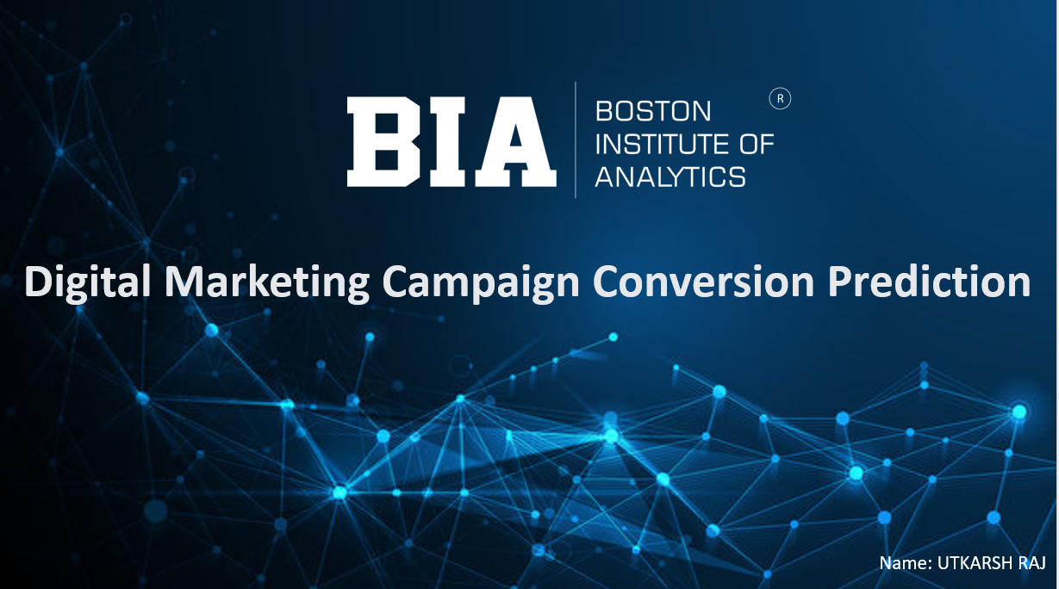

Slide 2

OPTIMIZING
DIGITAL
MARKETING CAMPAIGN
CONVERSION PREDICTION
USING MACHINE LEARNING
UTKARSH RAJ
CONFIDENTIAL: The information in this document belongs to Boston Institute of Analytics LLC. Any unauthorized sharing of this
material is prohibited and subject to legal action under breach of IP and confidentiality clauses.

Slide 3
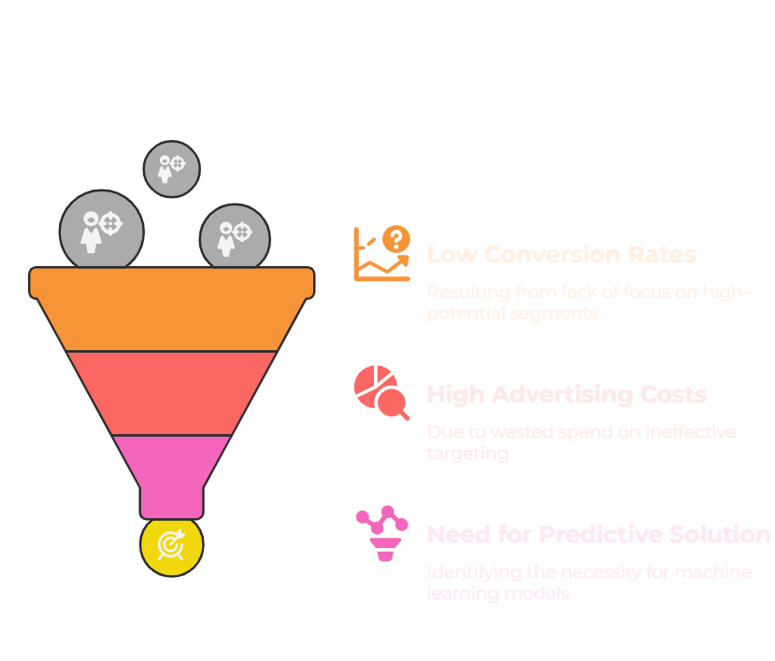
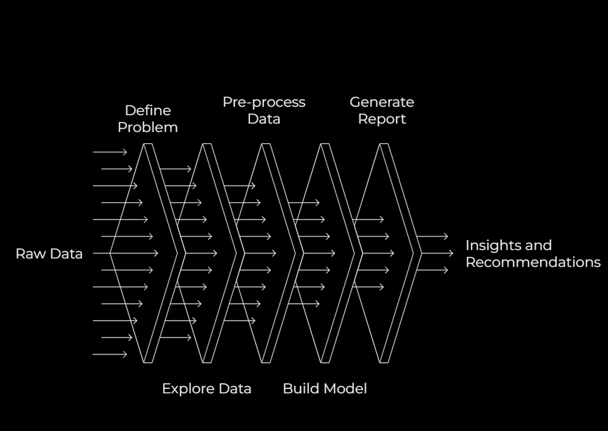
PROBLEM STATEMENT
The company is working on a project to improve its digital marketing by accurately predicting customer conversions. This is crucial for optimizing campaign performance and reducing inefficient targeting. The project uses machine learning to analyze customer demographics and engagement metrics to develop a solution that enhances campaign targeting, boosts conversion rates, and maximizes return on advertising spend. This will help improve campaign performance and ROAS.
CONFIDENTIAL: The information in this document belongs to Boston Institute of Analytics LLC. Any unauthorized sharing of this
material is prohibited and subject to legal action under breach of IP and confidentiality clauses.

Slide 4
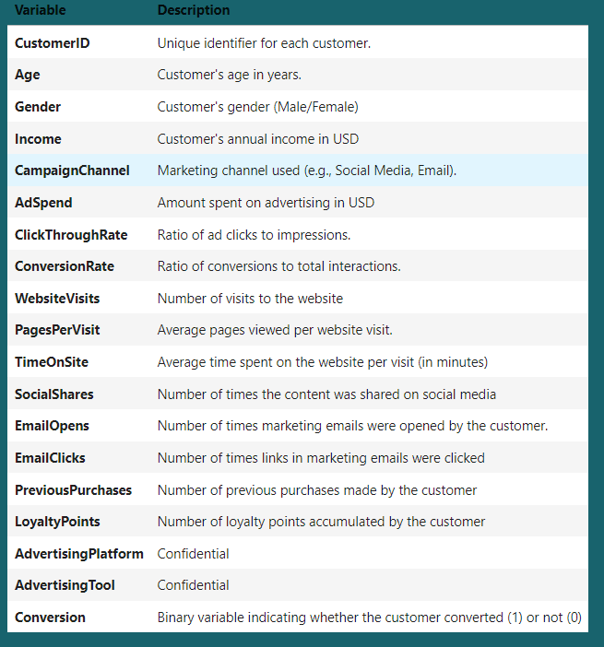
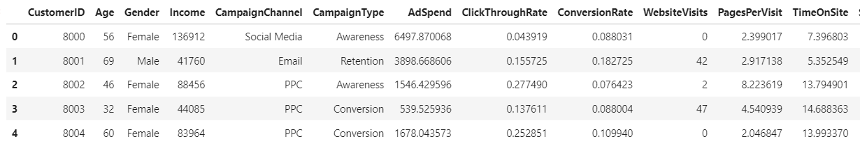
Data Description
• Dataset Source: The dataset, contains customer data for predicting conversions in digital marketing campaigns.
• Feature Categories: Includes demographics (e.g., Age, Gender, Income) and engagement metrics (e.g., WebsiteVisits, EmailClicks) to capture customer behavior.
• Target Variable: The target, Conversion, is binary (0 = No Conversion, 1 = Converted), indicating whether a customer converted after a campaign.
CONFIDENTIAL: The information in this document belongs to Boston Institute of Analytics LLC. Any unauthorized sharing of this
material is prohibited and subject to legal action under breach of IP and confidentiality clauses.

Slide 5
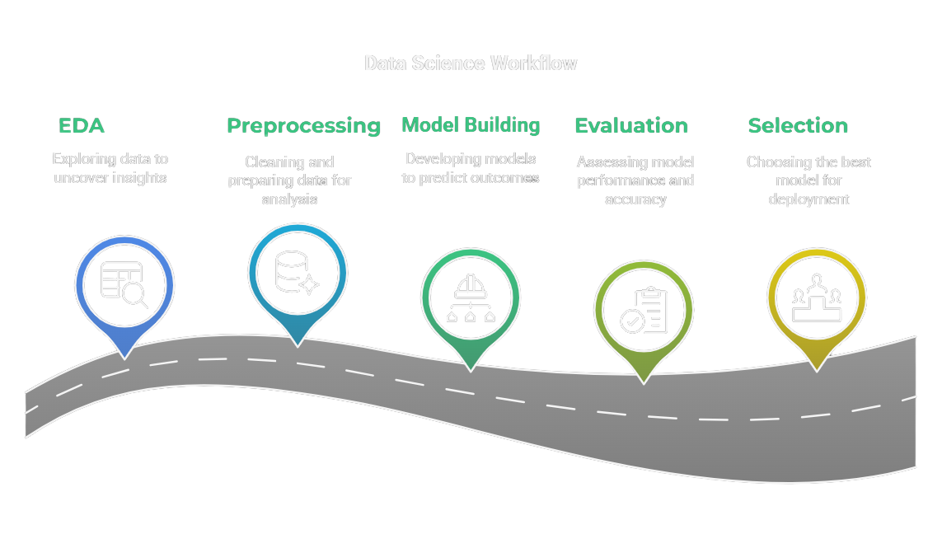
WORKFLOW
CONFIDENTIAL: The information in this document belongs to Boston Institute of Analytics LLC. Any unauthorized sharing of this
material is prohibited and subject to legal action under breach of IP and confidentiality clauses.

Slide 6
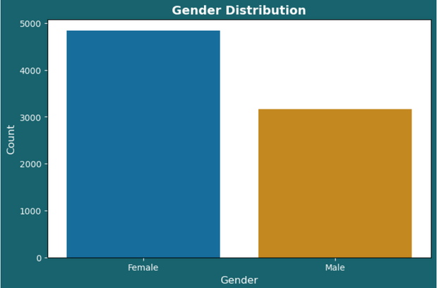
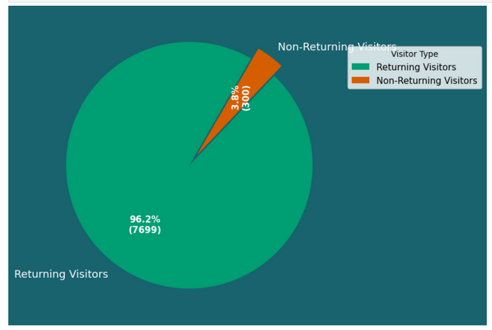
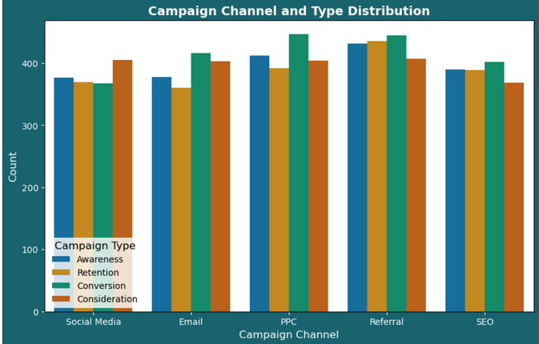
EXPLORATORY DATA ANALYSIS (EDA)
CUSTOMER DEMOGRAPHICS
Gender Distribution
Age and Income Distribution
Age and Income vs. Conversion
Gender and Age vs. Conversion
CUSTOMER ENGAMENT
Engagement Distribution
Website visit and Page per visit vs Campaign Type and Channel
Avg. Time on Site and Avg. loyalty point vs. Conversion
Percent of Returning Visitor
CAMPAGIN EFFECTIVENESS
Campaign Channel and Type Distribution
Ad. Spend and Click Through Rate Distribution
Click through Rate vs. Conversion
Campaign Type and Channel vs. Conversion
Total Ad. Spend vs. Conversion
CONFIDENTIAL: The information in this document belongs to Boston Institute of Analytics LLC. Any unauthorized sharing of this
material is prohibited and subject to legal action under breach of IP and confidentiality clauses.

Slide 7
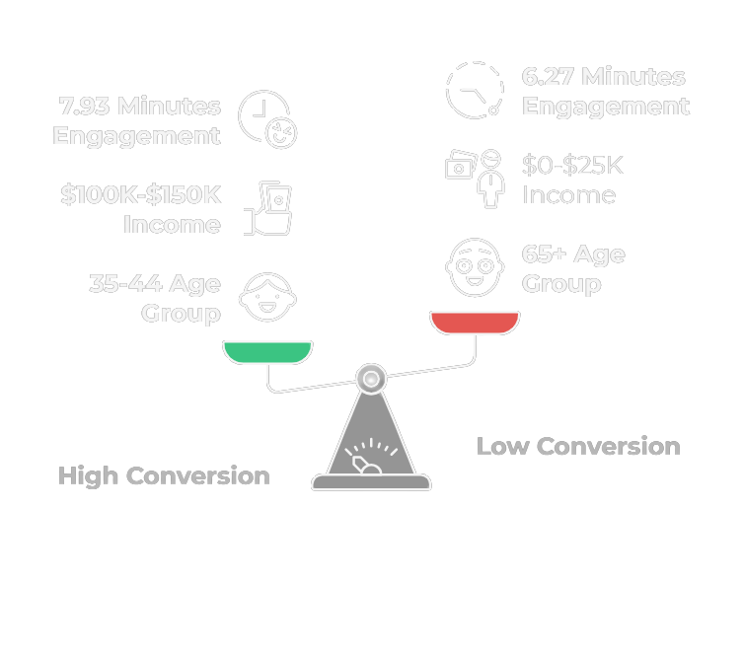
EXPLORATORY DATA ANALYSIS INSIGHTS
•Age and Income Trends: Found the 35-44 age group (1,603 customers) and $100K-$150K income range with the highest conversions, while 65+ (617) and $0-$25K had the least.
•Engagement Patterns: Converters spend more time on site (7.93 vs. 6.27 minutes) and have higher loyalty points (2,500 vs. 2,200), indicating engagement drives conversions.
•Channel Effectiveness: Referral campaigns lead in conversions, while Awareness and Retention channels show high non-conversions, guiding campaign focus.
CONFIDENTIAL: The information in this document belongs to Boston Institute of Analytics LLC. Any unauthorized sharing of this
material is prohibited and subject to legal action under breach of IP and confidentiality clauses.

Slide 8
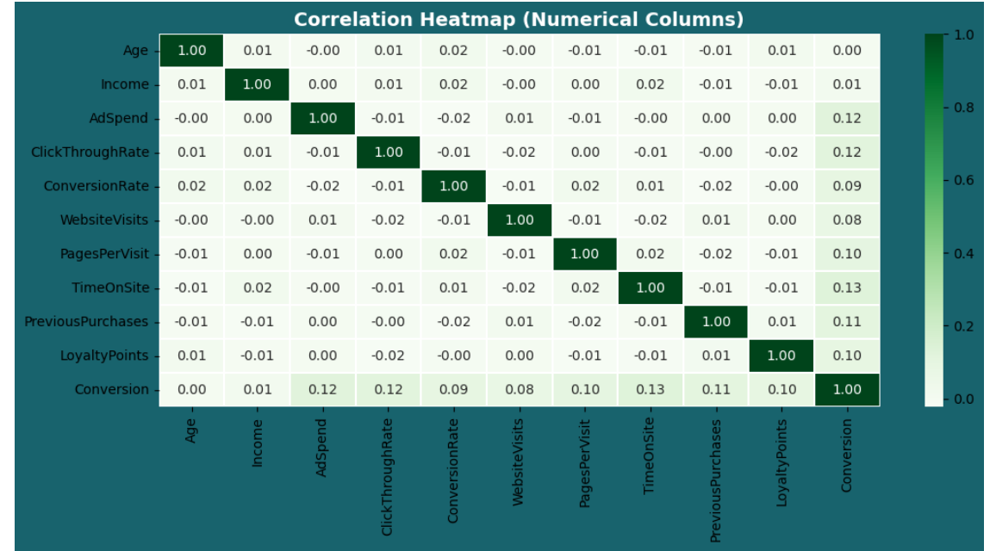
CORRELATION HEATMAP
Conversion Drivers: Conversion correlates most with TimeOnSite (0.13), AdSpend (0.12), ClickThroughRate (0.12), and PreviousPurchases (0.11), showing these features drive conversions.
Weak Correlations: Age, Income, and LoyaltyPoints show low correlations with Conversion (0.00-0.01), suggesting limited direct impact.
CONFIDENTIAL: The information in this document belongs to Boston Institute of Analytics LLC. Any unauthorized sharing of this
material is prohibited and subject to legal action under breach of IP and confidentiality clauses.

Slide 9
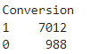
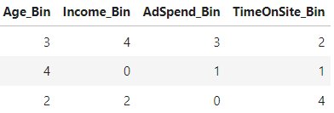
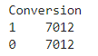
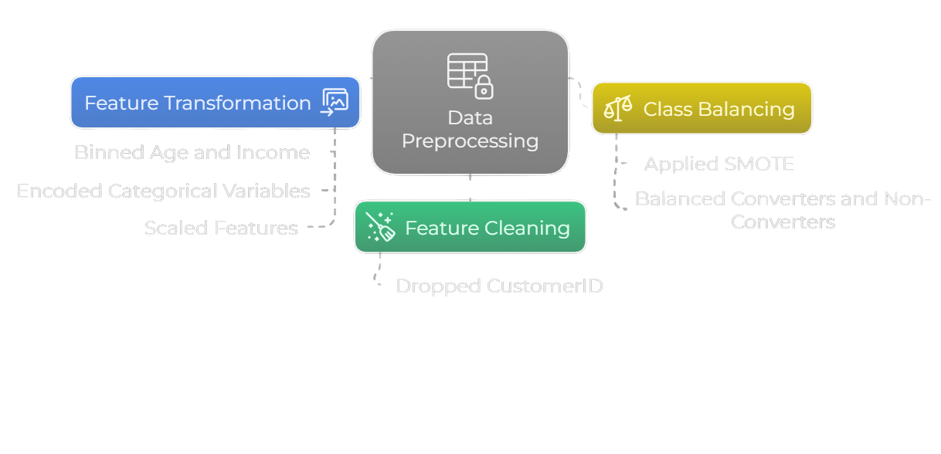
DATA PREPROCESSING
Feature Cleaning: Dropped CustomerID to focus on relevant conversion drivers.
Feature Transformation: Binned Age and Income into 5 quantiles, encoded categoricals (e.g., Gender), and scaled features with StandardScaler.
Class Balancing: Used SMOTE to balance Conversion, improving model performance on minority classes.
BEFORE SMOTE
AFTER BINNING
AFTER SMOTE
CONFIDENTIAL: The information in this document belongs to Boston Institute of Analytics LLC. Any unauthorized sharing of this
material is prohibited and subject to legal action under breach of IP and confidentiality clauses.

Slide 10
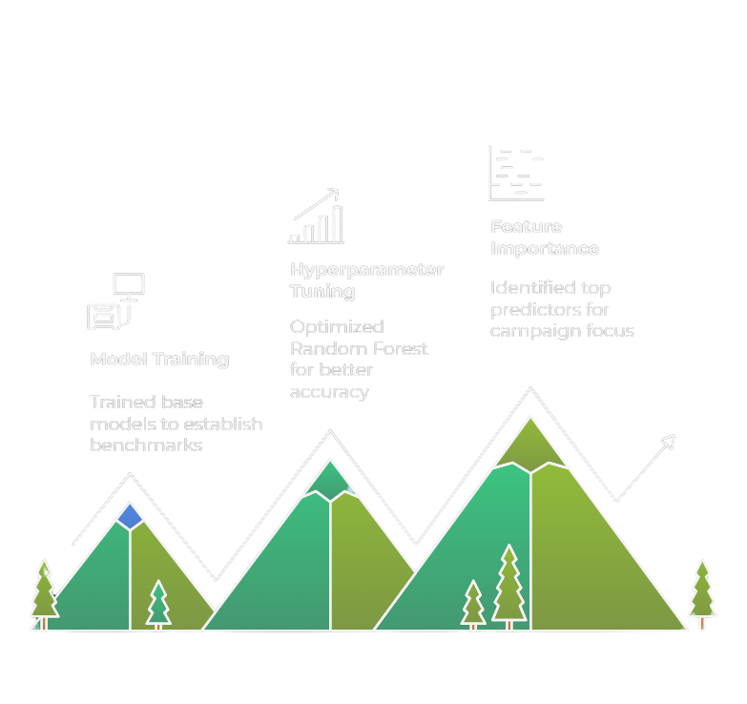
MODEL BULDING
Model Training: Trained base models including Logistic Regression, Decision Tree, Random Forest, SVC, XGBoost, and CatBoost on the preprocessed dataset to establish initial performance.
Hyperparameter Tuning: Used GridSearchCV to optimize Random Forest, selecting n_estimators=300 and max_depth=None, improving accuracy from 96% (base) to 97% (tuned).
Feature Importance: Identified EmailClicks, TimeOnSite_Bin, and PreviousPurchases as top predictors, guiding campaign focus on engaged customers.
CONFIDENTIAL: The information in this document belongs to Boston Institute of Analytics LLC. Any unauthorized sharing of this
material is prohibited and subject to legal action under breach of IP and confidentiality clauses.

Slide 11
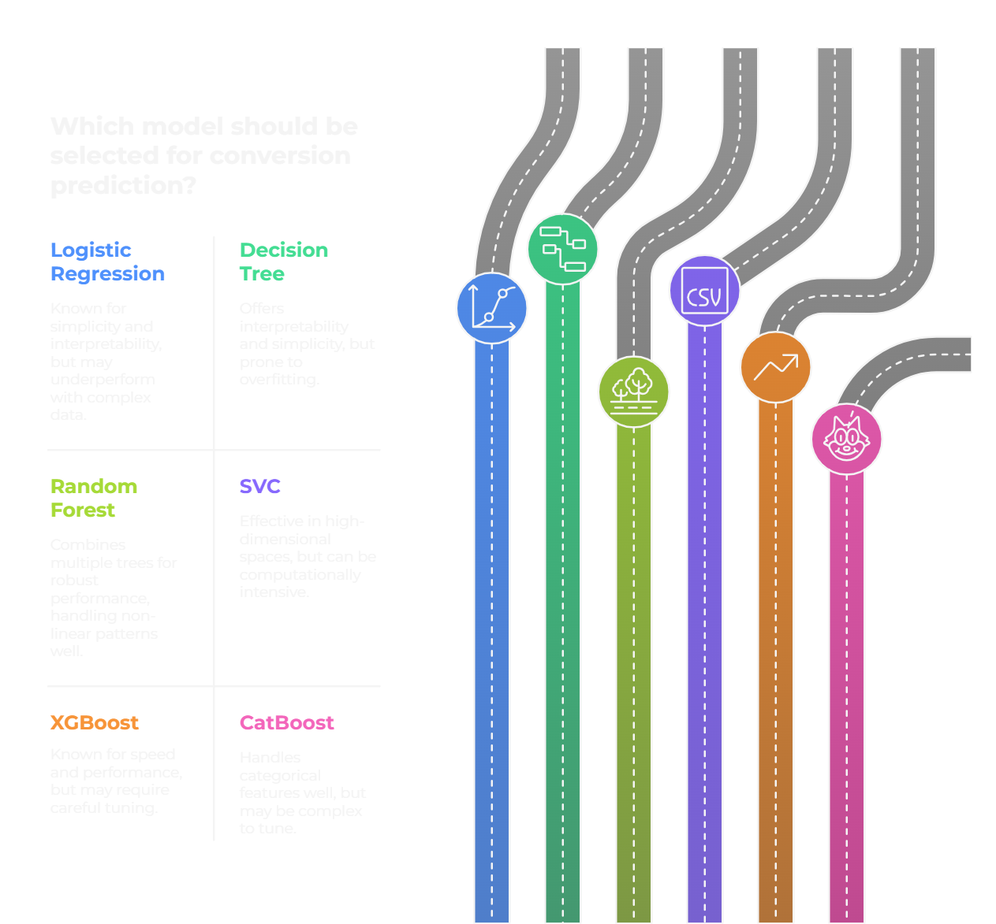
CONFIDENTIAL: The information in this document belongs to Boston Institute of Analytics LLC. Any unauthorized sharing of this
material is prohibited and subject to legal action under breach of IP and confidentiality clauses.

Slide 12
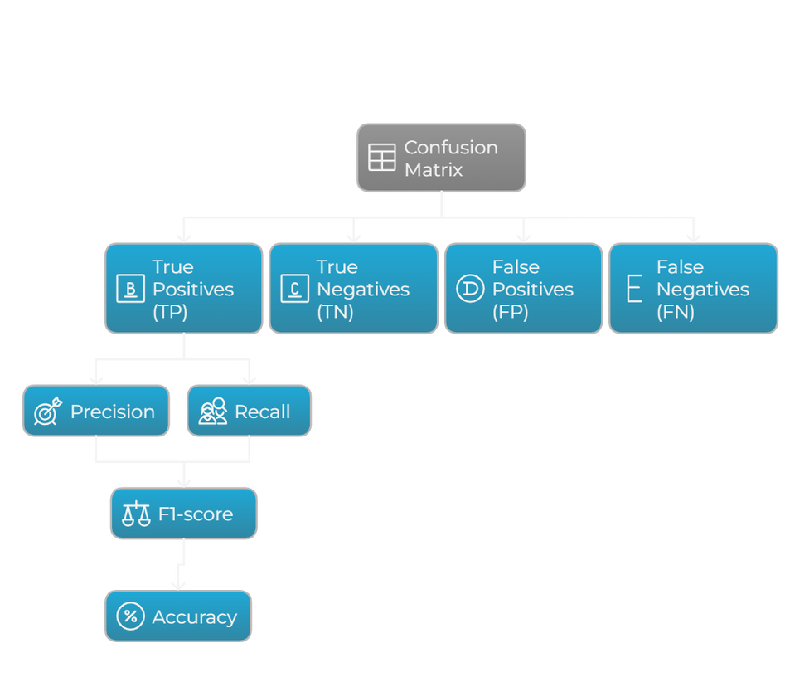
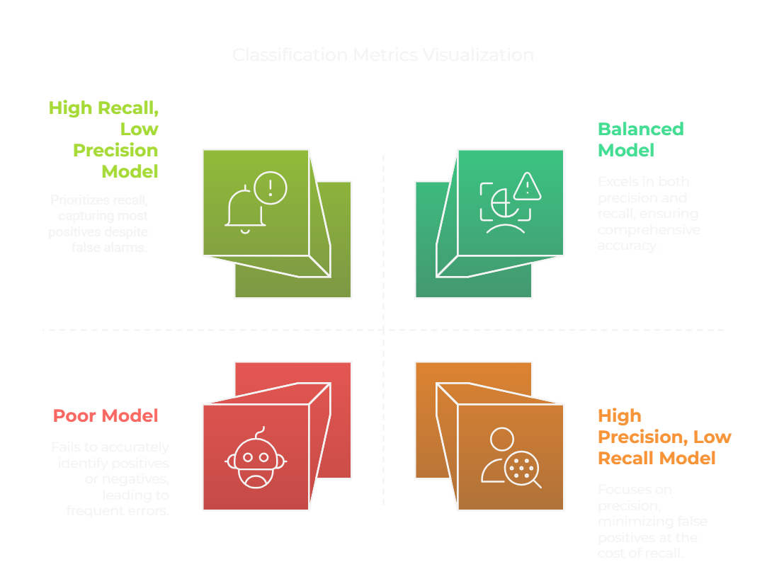
Evaluation Matrix
CONFIDENTIAL: The information in this document belongs to Boston Institute of Analytics LLC. Any unauthorized sharing of this
material is prohibited and subject to legal action under breach of IP and confidentiality clauses.

Slide 13
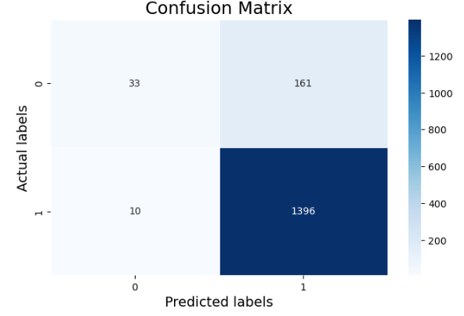
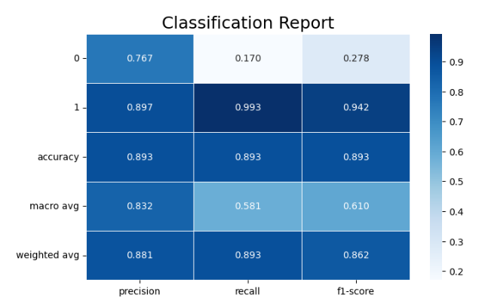
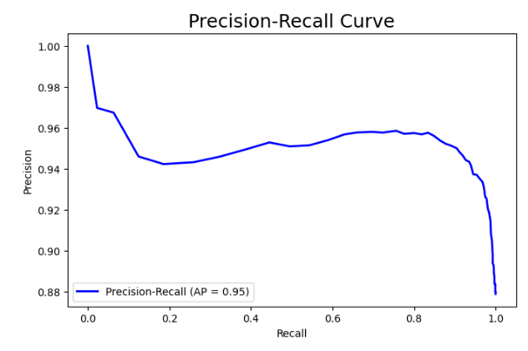
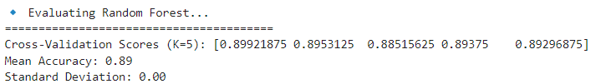
Evalution (Without Preprocessing)
CONFIDENTIAL: The information in this document belongs to Boston Institute of Analytics LLC. Any unauthorized sharing of this
material is prohibited and subject to legal action under breach of IP and confidentiality clauses.

Slide 14
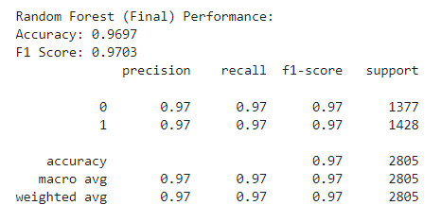
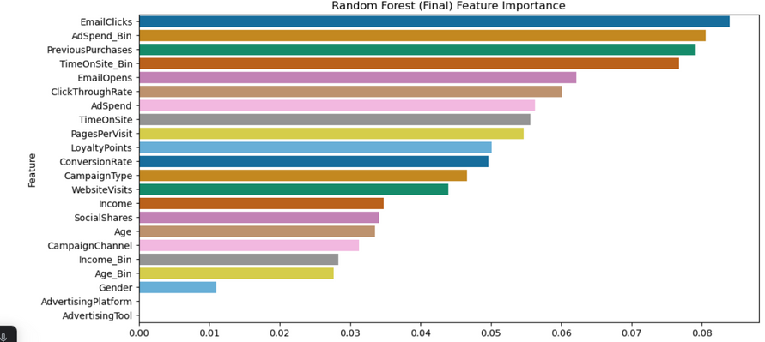
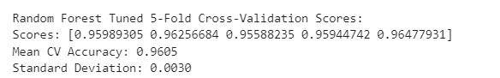
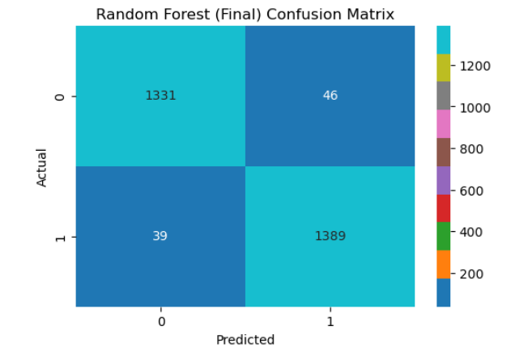
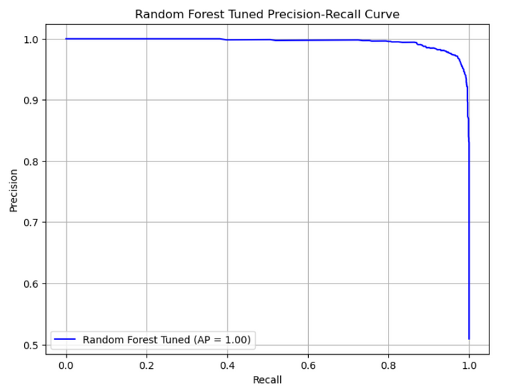
Evalution (With Preprocessing)
CONFIDENTIAL: The information in this document belongs to Boston Institute of Analytics LLC. Any unauthorized sharing of this
material is prohibited and subject to legal action under breach of IP and confidentiality clauses.

Slide 15
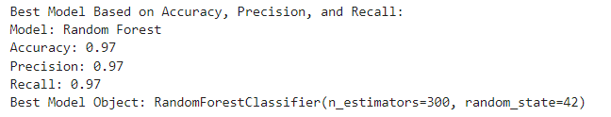
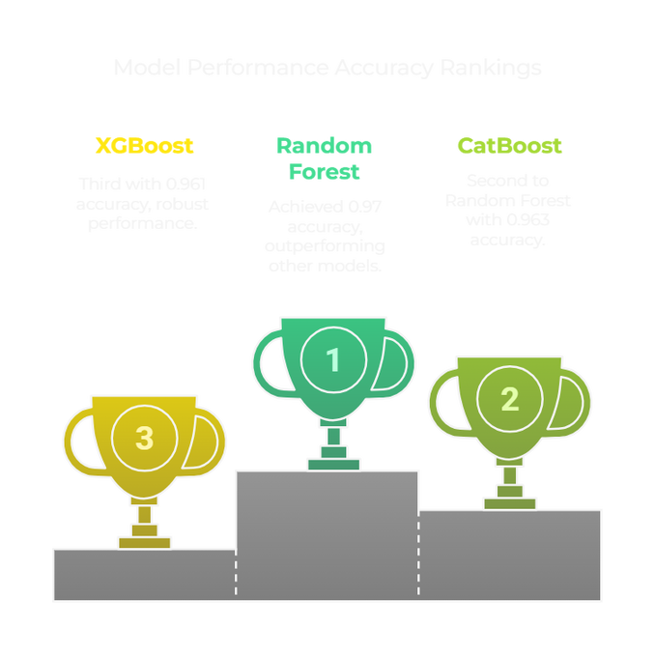
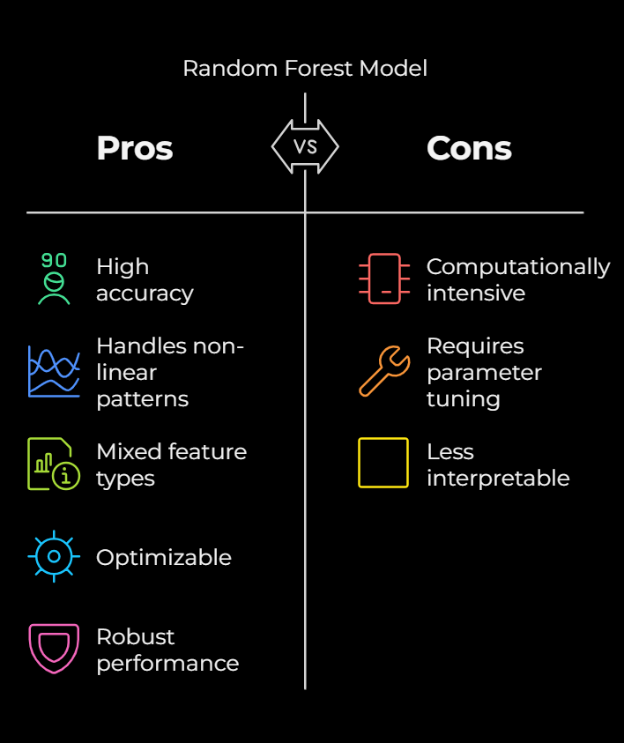
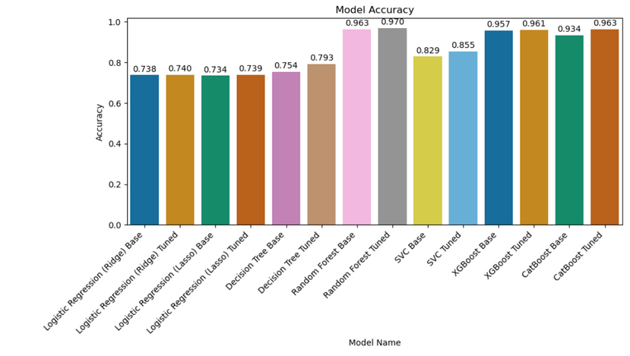
MODEL SELECTION
Random Forest Metrics: Achieved 97% accuracy with a classification matrix of precision 97%, recall 97%, and F1-score 97% for both classes, ensuring balanced performance.
Class-wise Breakdown: For non-converters (0), precision, recall, and F1-score are 0.97; for converters (1), all metrics are also 0.97, showing consistent prediction quality.
Model Comparison: Outperformed XGBoost (96%), CatBoost (96%), and SVC (85%), with a 5-fold CV mean accuracy of 0.961 (std: 0.0030) for robustness.
CONFIDENTIAL: The information in this document belongs to Boston Institute of Analytics LLC. Any unauthorized sharing of this
material is prohibited and subject to legal action under breach of IP and confidentiality clauses.

Slide 16
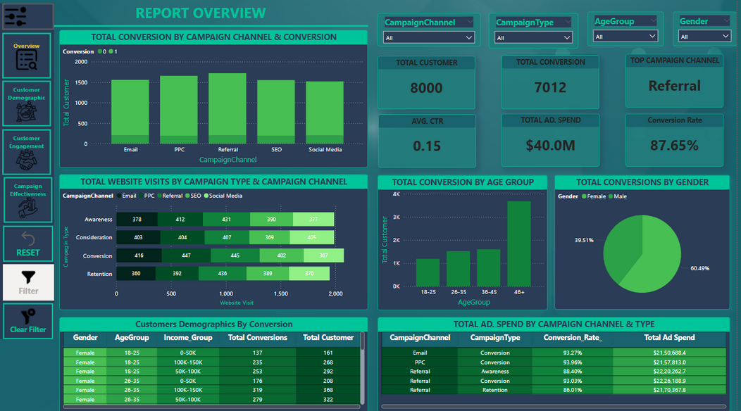
KEY INSIGHTS ON
BI REPORT
Target High-Potential Segments: Focus on 35-44 age and $100K-$150K income customers, as they exhibit the highest conversion likelihood based on demographic trends.
Enhance Engagement: Prioritize customers with higher engagement (e.g., more time on site, loyalty points), as they are more likely to convert, improving campaign effectiveness.
Optimize Campaign Channels: Invest in referral campaigns, which outperform others, while refining Awareness and Retention strategies to reduce non-conversions.
CONFIDENTIAL: The information in this document belongs to Boston Institute of Analytics LLC. Any unauthorized sharing of this
material is prohibited and subject to legal action under breach of IP and confidentiality clauses.

Slide 17
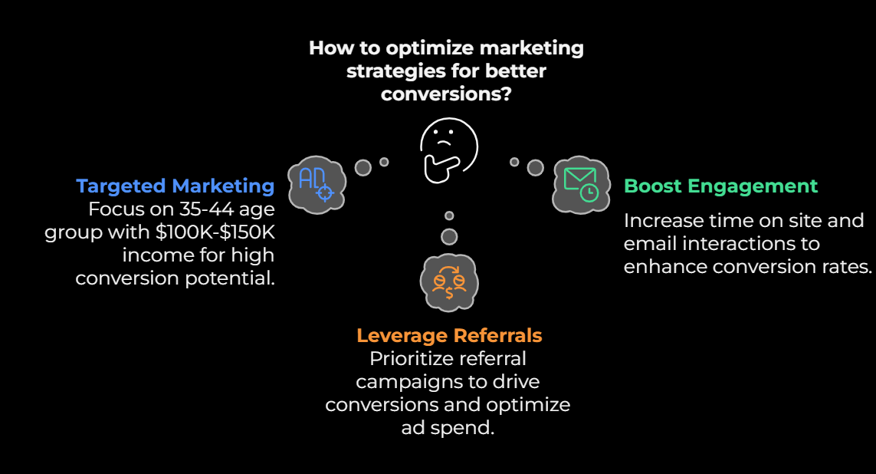
RECOMMENDATION
CONFIDENTIAL: The information in this document belongs to Boston Institute of Analytics LLC. Any unauthorized sharing of this
material is prohibited and subject to legal action under breach of IP and confidentiality clauses.

Slide 18
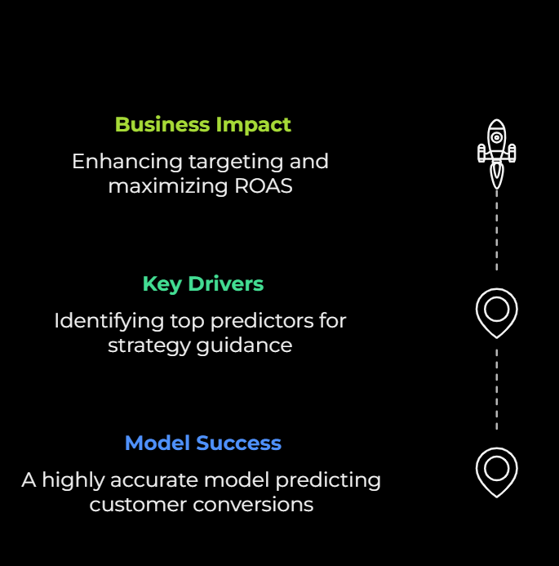
Conclusion
Model Success: Random Forest model achieved 97% accuracy, effectively predicting customer conversions for digital marketing campaigns.
Key Drivers: Identified EmailClicks and TimeOnSite as top predictors, guiding targeted strategies for higher conversions.
Business Impact: Enhances targeting, boosts conversion rates, and maximizes ROAS through data-driven campaign optimization.
CONFIDENTIAL: The information in this document belongs to Boston Institute of Analytics LLC. Any unauthorized sharing of this
material is prohibited and subject to legal action under breach of IP and confidentiality clauses.

Slide 19

QUESTIONS?
CONFIDENTIAL: The information in this document belongs to Boston Institute of Analytics LLC. Any unauthorized sharing of this
material is prohibited and subject to legal action under breach of IP and confidentiality clauses.

Slide 20

CONFIDENTIAL: The information in this document belongs to Boston Institute of Analytics LLC. Any unauthorized sharing of this
material is prohibited and subject to legal action under breach of IP and confidentiality clauses.

